Slide 1




ActiRewards
By:
Bit_Borg

Slide 2
Problem Definition
The company ABC is facing the challenge of maintaining a strong sense of community and enhancing the team member experience during an office relocation. With the move to a more spacious and modern building, there is a need to ensure that employees feel connected, engaged, and rewarded for their contributions. However, without a structured system in place, it becomes difficult to foster inclusivity, encourage participation in extracurricular activities, and provide a seamless way to earn and redeem rewards. This lack of a cohesive solution hampers employee engagement and may result in a loss of morale and productivity.
Page 1

Slide 3


Solution
To address the aforementioned challenges and create a positive employee experience, ABC has proposed the development of a mobile app called "ActiRewards".With a strong focus on fostering a sense of community and enhancing team member engagement, ActiRewards offers a range of features that empower employees to earn and redeem captivating non-monetary rewards while promoting a culture of collaboration and recognition.
At the core of ActiRewards lies the intuitive Token Dashboard, a central hub where employees can effortlessly track their token balance, review transaction history, and monitor their overall engagement progress. Beyond the traditional earning avenues such as carpooling and extracurricular activities, ActiRewards introduces innovative features, including the Employee Referral program, and the Community Service engagement.
Page 2

Slide 4
Solution
Unlocking a realm of redemption, ActiRewards presents a captivating Rewards Marketplace, where employees can indulge in a curated selection of non-monetary rewards. From exclusive office updates to bespoke treasures, these rewards transform the workspace into a haven of inspiration and celebration. With its user-friendly interface and unwavering commitment to privacy and security, ActiRewards seamlessly guides employees engagement and connection, sparking collaboration and celebrating achievements.
Page 3

Slide 5
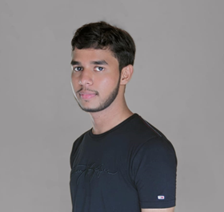
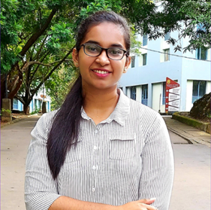
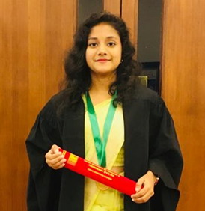
Meet our Team
Pasan Kavinda Abeysekara pasankavindaabey@gmail.com https://lk.linkedin.com/in/pasan-kavinda
071 900 0492
University of Ruhuna
Dampage Nawodhi Mabheesha Fernando nawomabhee22@gmail.com
https://linkedin.com/in/mabheesha-fernando
077 534 9863
University of Ruhuna
Athukoralage Uduli Taneesha Iyenshi iyenshiaut@gmail.com
http://linkedin.com/in/taneesha-iyenshi
076 470 9893
University of Ruhuna
Page 4

